Slide 1
MUGWAGWA P
MAPIKA C
DANDARE T
NHONGO L

Slide 2
AREAS OF FOCUS
Conceptual analysis of agricultural extension approaches
Overview of food and agricultural programmes
Extension paradigms-societal development stages
Guiding principals of dimensions of extensions

Slide 3
EXTENSION APPROACHES
Extension approaches in agriculture programs refer to the methods and strategies used to:
Disseminate information
Provide training
Support farmers in adopting new practices and technologies
Supporting group formation and facilitating collective action
Some common extension approaches in agriculture programs include:

Slide 4
1. Farmer Field Schools
A participatory and experiential learning approach where farmers come together to learn new techniques and practices through hands-on activities in the field.
Hands on

Slide 5
2. Demonstrations and Field Days
Involve showcasing new technologies or practices on a farm or in a field to allow farmers to see the benefits firsthand and ask questions

Slide 6
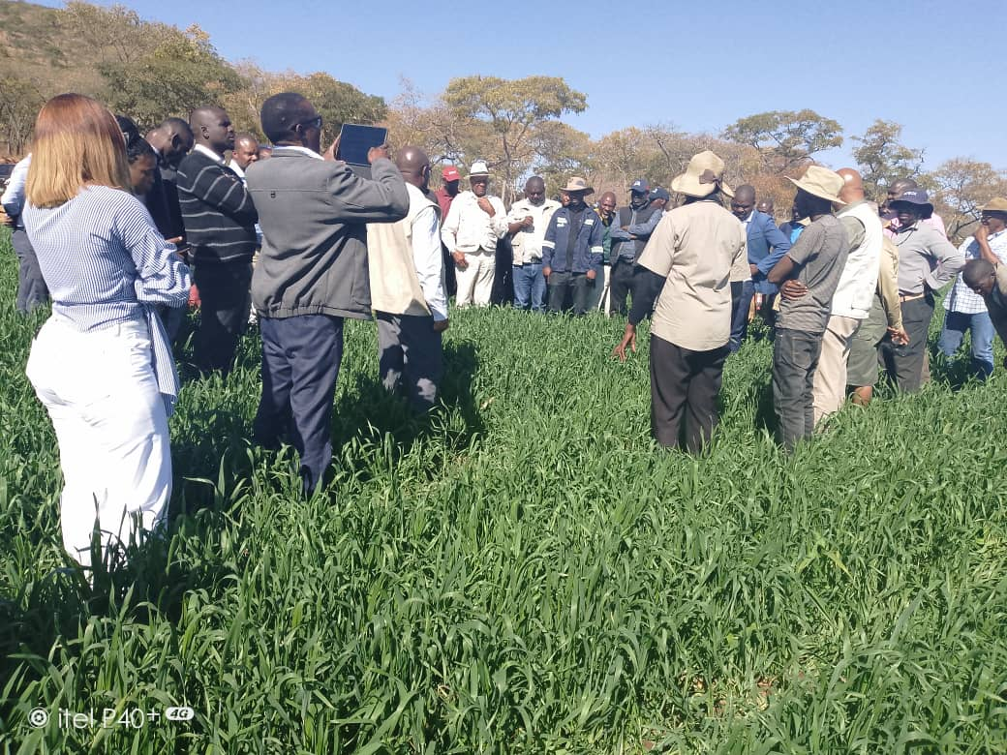
A field day

Slide 7
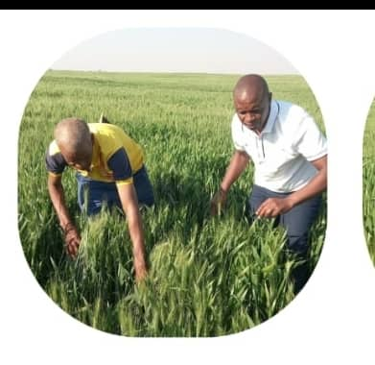
3. Farmer-to-Farmer Extension
This approach involves training and empowering successful farmers to serve as extension agents and share their knowledge and experiences with other farmers in their community.

Slide 8
4. USE OF MASS MEDIA
Broadcasting agricultural information and training programs on radio and TV can reach a wide audience and provide valuable information to farmers
Use of internet and all social media platforms

Slide 9
5.Participatory Rural Appraisal (PRA)
Involves working closely with farmers to understand their needs, priorities, and constraints, and co-designing solutions with them.

Slide 10
6.Group Approaches:
Working with farmer groups, cooperatives, or associations can be an effective way to reach and support a larger number of farmers and facilitate peer learning and knowledge sharing.

Slide 11
7.Value Chain Approaches
Focus on improving the entire agricultural value chain, from production to marketing, to increase farmers' income and competitiveness.

Slide 12
8.Gender-sensitive Approaches
Designing extension programs that are gender-sensitive and address the specific needs and constraints faced by women farmers can help promote gender equality and empower women in agriculture. e.g Agric4She

Slide 13
OVERVIEWOF FOOD AND AGRICULTURAL PROGRAMMES

Slide 14
Presidential Wheat Programme
Presidential Tick Grease Blitz Programme
Horticulture Development Programme
Pfumvudza/Intwasa Programme
Livestock Growth Plan – 300 000 doses of BOLVAC vaccine for January disease rolled out; hay baling; urea for silage for livestock

Slide 15
Presidential Goat Programme
Presidential Fish Programme
Agric4SHE Programme – poultry, farming inputs, etc –
Smallholder Irrigation Revitalization Programme – ARDA, Department of Irrigation

Slide 16
EXPLORING HOW DIFFERENT EXTENSION PARADIGMS HAVE EVOLVED ALONGSIDE SOCIETAL DEVELOPMENT STAGES

Slide 17
Traditional Extension Paradigm
Top-down, technology transfer approach, with extension agents as the primary source of information.
Assumed that farmers would readily adopt new technologies and practices recommended by experts.

Slide 18
Participatory Extension Paradigm
Emphasis on involving farmers in the extension process, recognizing their local knowledge and needs.
Shift from technology transfer to a two-way exchange of information and joint problem-solving.

Slide 19
Pluralistic Extension Paradigm
Developed in response to the limitations of the traditional, top-down approach.
Involves a diverse range of public, private, and civil society actors in providing extension services.

Slide 20
Innovation Systems Paradigm
Emerged in more advanced economies and societies.
Views agricultural innovation as the result of complex interactions among various actors, including farmers, researchers, input suppliers, and policymakers.

Slide 21
GUIDING PRINCIPLES AND DIMENSIONS OF AGRICULTURAL EXTENSION
Farmer-Centricity
Placing farmers and their needs at the center of extension activities.
Participatory Approach
Actively involving farmers in the extension process, from problem identification to solution development.
Pluralism
Incorporating diverse sources of knowledge and expertise, including public, private, and civil society actors.

Slide 22
GUIDING PRINCIPLES
Sustainability
Promoting environmentally, economically, and socially sustainable agricultural practices.
Equity and Inclusiveness
Ensuring that extension services reach and benefit all farmers, especially marginalized groups.
Evidence-Based
Basing extension strategies and interventions on empirical research and data.

Slide 23
DIMENSIONS OF EXTENSION
Educational Dimension
Providing training, demonstrations, and workshops to enhance farmers' knowledge and skills.
Utilizing a variety of teaching methods, such as farmer field schools, farmer-to-farmer extension, and mass media campaigns.
Advisory Dimension
Offering personalized advice and recommendations to farmers based on their specific needs and contexts.
Facilitating the exchange of information and experiences between farmers and extension agents.

Slide 24
DIMENSIONS OF EXTENSION
Facilitative Dimension
Helping farmers access inputs, credit, markets, and other resources necessary for agricultural production.
Fostering linkages and partnerships between farmers, researchers, and other stakeholders.
Innovative Dimension:
Promoting the development, testing, and adaptation of new technologies, practices, and approaches.
Facilitating the sharing of knowledge and innovations among farmers, researchers, and other actors.

Slide 25
DIMENSIONS OF EXTENSION
Empowerment Dimension
Encouraging collective action and the development of farmer organizations and cooperatives.
These guiding principles and dimensions of extension help ensure that agricultural extension services are responsive, inclusive, and effective in addressing the diverse needs and challenges faced by farmers.

Slide 26
References
Food and Agriculture Organization of the United Nations. (n.d.). The State of Food and Agriculture 2017. Retrieved from http://www.fao.org/3/i2490e/i2490e01c.pdf
Food and Agriculture Organization of the United Nations. (n.d.). The State of Food Security and Nutrition in the World. Retrieved from http://www.fao.org/state-of-food-security-nutrition/en/
Food and Agriculture Organization of the United Nations. (2014). The Extension and Advisory Services Toolkit.
Global Report on Food Crises. (2023). Retrieved from https://www.fsinplatform.org/sites/default/files/resources/files/GRFC2023-brief-EN.pdf

Slide 27
Rivera, W. M. (2001). Agricultural extension, rural development, and the persistence of poverty. Journal of International Agricultural and Extension Education, 8(1), 5-14.
Swanson, B. E. (2008). Global review of good agricultural extension and advisory service practices. Food and Agriculture Organization of the United Nations.
World Bank. (n.d.). Ending Poverty and Hunger by 2030: An Agenda for the Global Food System. Retrieved from http://documents.worldbank.org/curated/en/700061468334490682/Ending-poverty-and-hunger-by-2030-an-agenda-for-the-global-food-system

Slide 28
TATENDA
SIYABONGA
THANK YOU!!!!!!

